Slide 1
Simulating Quantum Many Body Dynamics on a current Quantum Computer
Rajat Arunachala Chandavar
Computational Science and Engineering
Advised by: Richard Milbradt

Slide 2
Content
Quantum Many Body Dynamics
Setup
Implementation
Results
Summary

Slide 3
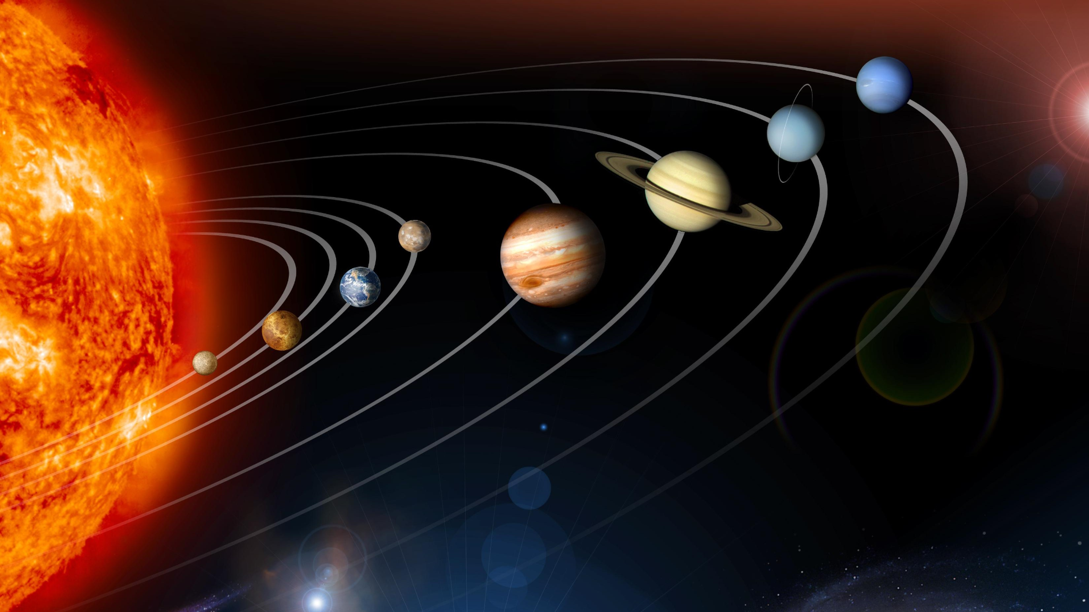
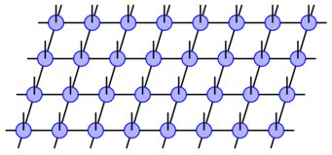
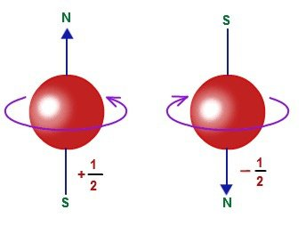
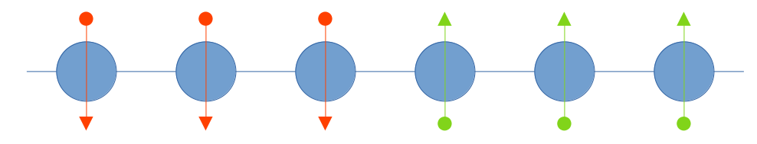
Quantum Many Body Dynamics (1) - Introduction
Goal of this study:
To simulate evolution of a 1D spin-½ chain on a current quantum computer.
Notes:
behaviour of systems with large number of interacting particles
time evolution of systems composed of many interacting quantum particles.
Spin is an intrinsic property of elementary particles
Describe inherent angular momentum.

Slide 4
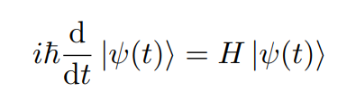
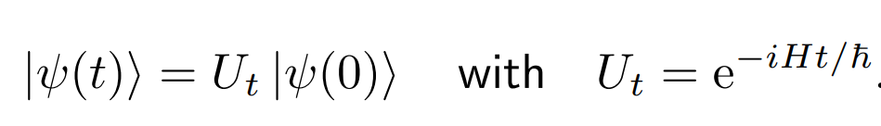

Setup (1)
Governing equation: Schrödinger equation
General Hamiltonian for quantum many body physics
Notes:
QC perspective – single and multiple qubit gates

Slide 5


Setup (2)
2 distinct cases for Hamiltonian parameters
Case (i) - XX chain - U = 0, h_{j} = 0
Case (ii) - Disordered XX chain - U = 0, h_{j} sampled from [-h, +h]
Initial State: 6 particle domain wall - | 1 1 1 0 0 0 >
Observables
Local Magnetization
Notes:
Ket 0 and 1 are eigen vectors of sigma z

Slide 6




Implementation - (1)
Trotter decomposition of Unitary time evolution operator U(t) = e^{-iHt}
Idea: Break down complex operator to a sequence of simpler operators
Baker–Campbell–Hausdorff formula,
Notes:
Shorten Idea

Slide 7
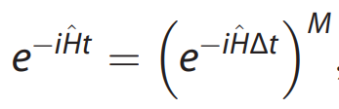
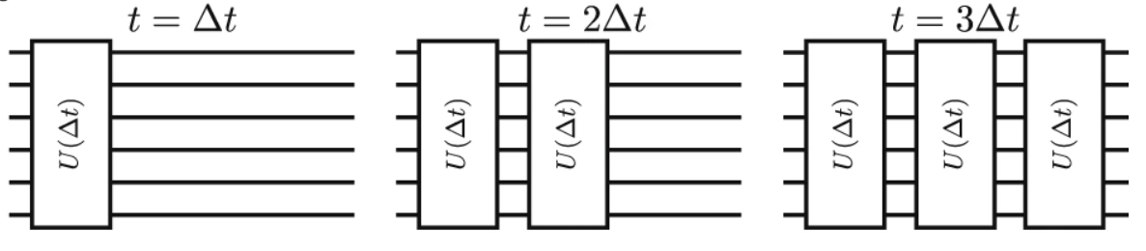
Implementation - (2)
Step 1: Split operator into discrete evolution operators

Slide 8
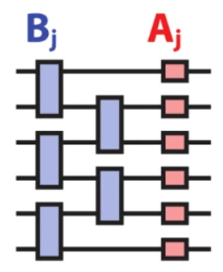
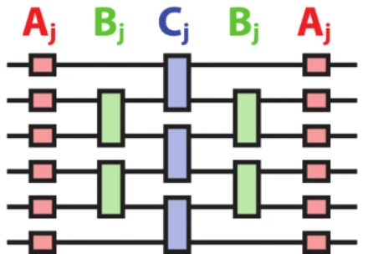
Implementation - (3)
Step 2: Approximate the discrete evolution operators - 2 options:
Basic
If H = A + B
e^{-iHΔt} = e^{-iAΔt} e^{-iBΔt} + O(Δt²)
Symmetric
If H = A + B
e^{-iHΔt} = e^{-iAΔt/2} e^{-iBΔt} e^{-iAΔt/2} + O(Δt³)
Notes:
Write order

Slide 9
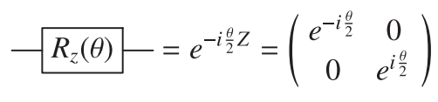

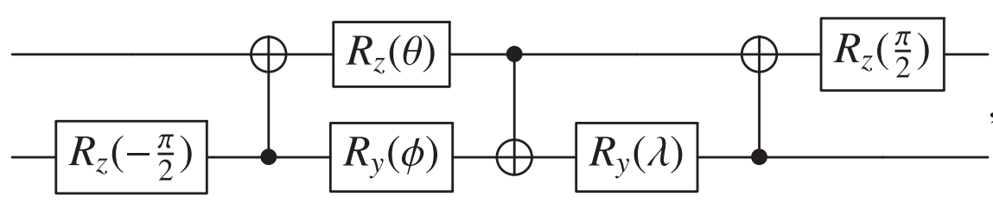
Implementation (4)
Step 3: implement A_{j}, B_{j} and C_{j}
For A_{j}, use the R_{z} gate.
For B_{j} and C_{j}:
Notes:
Qiskit

Slide 10

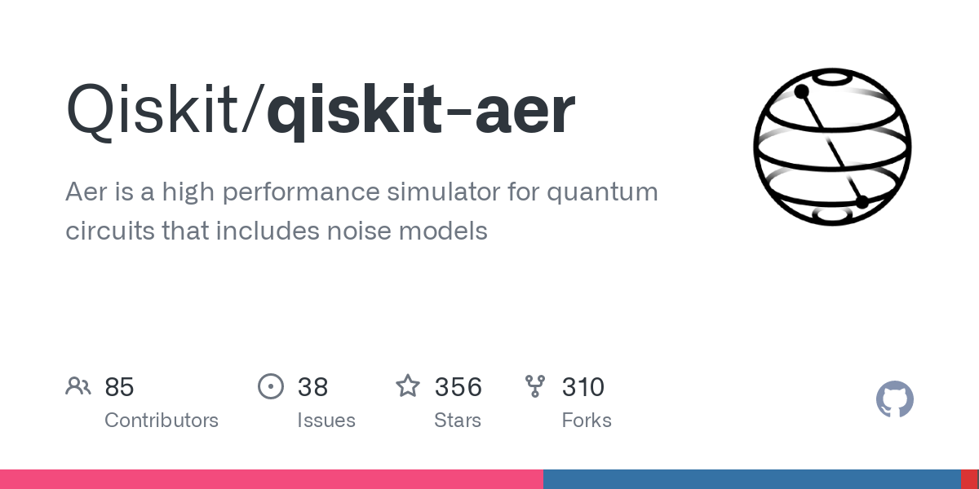
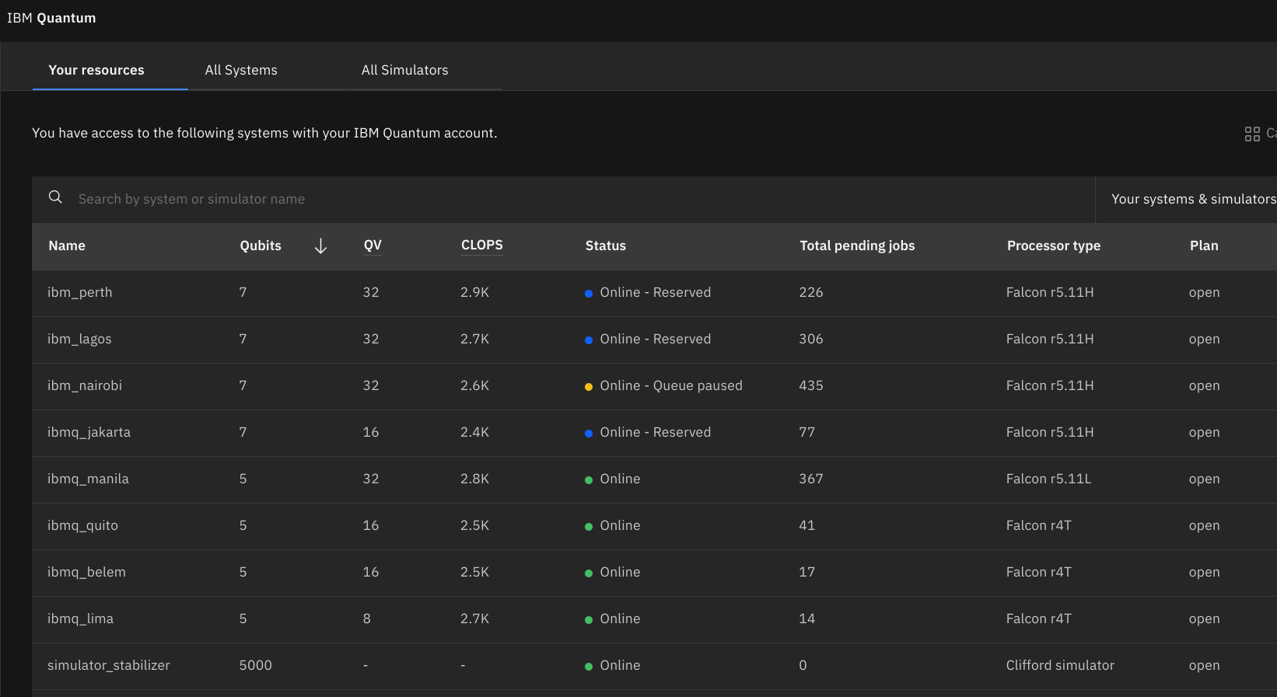
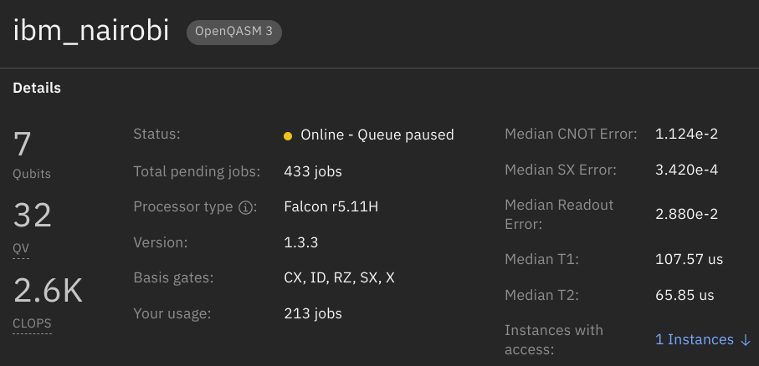
Implementation (5)
Notes:
CNOT higher error

Slide 11
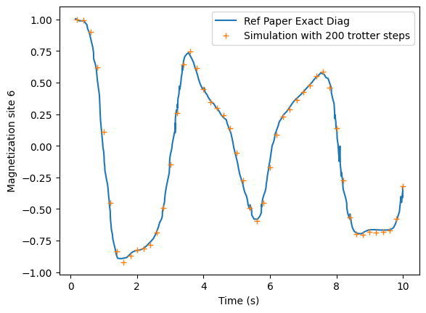
Results (1) - Verification of results with reference
Comparison of simulator and Reference Paper results
Note: For each final time value, a fixed number of trotter steps is done in this analysis.

Slide 12
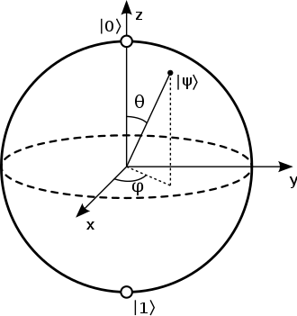
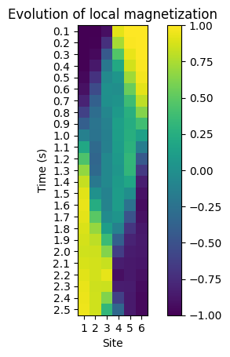
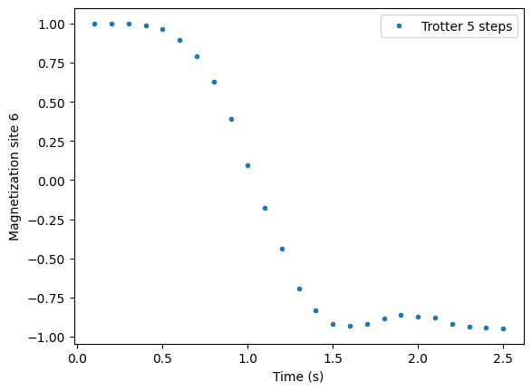
Results (2) - XX chain - Simulator
Local Magnetization at site 6 run on simulator

Slide 13
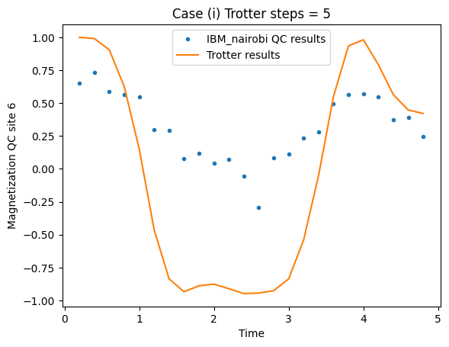
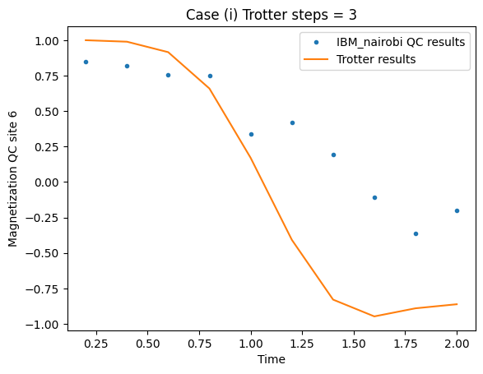
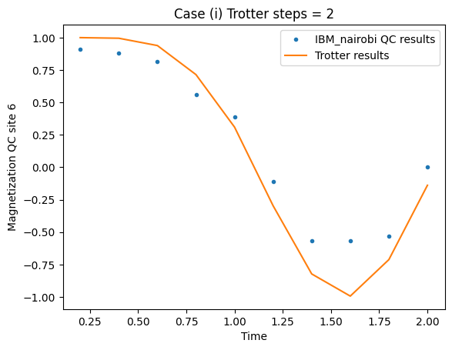
Results (3) - XX chain - IBM 6 Qubit QC
Influence of Trotter steps
Circuit with low depth -> More accurate

Slide 14
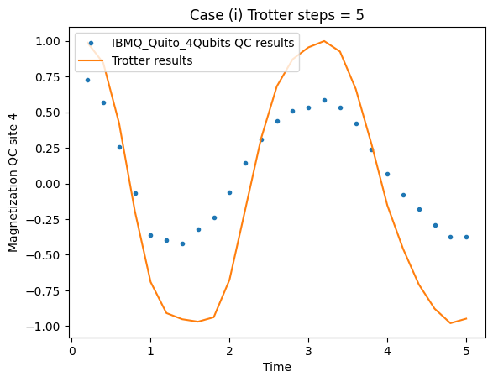
Results (3) - XX chain - IBM QC
Influence of number of qubits
6 qubit system
4 qubit system

Slide 15
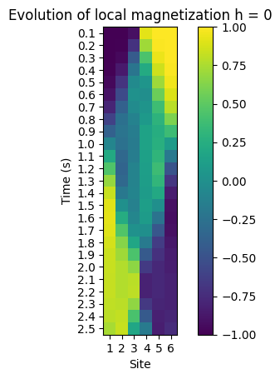
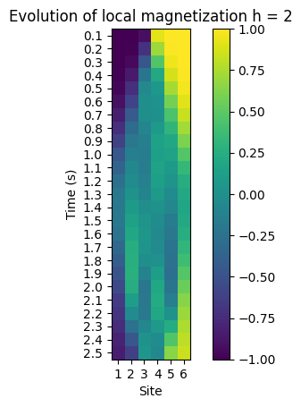
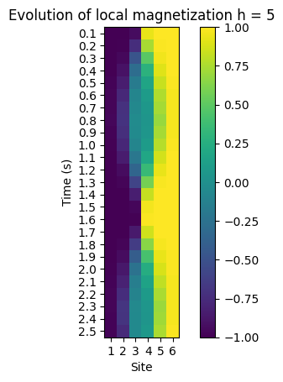
Results (4) - Disordered XX - (1)
Notes:
Ket 0 and 1 eigen vectors of sigma z

Slide 16
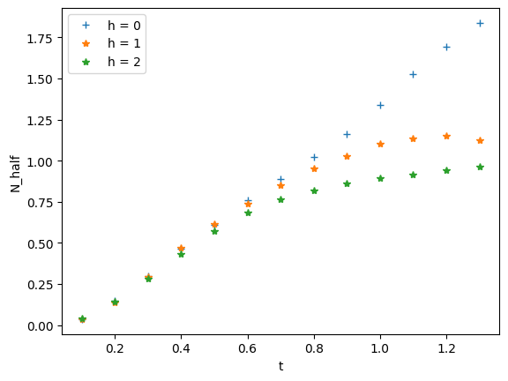
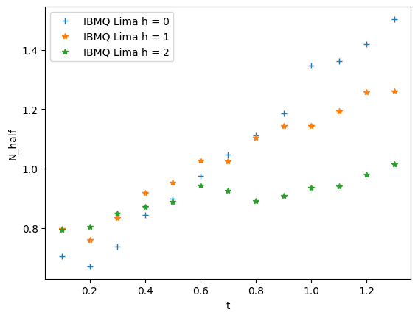
Results (4) - Disordered XX - (2)
Simulator 4 qubits
IBM 4 qubit Quantum Computer

Slide 17
Summary
IBM quantum computers have low quantitative accuracy
Accuracy improved with reduced circuit depths (lower evolution times) and lesser qubits (smaller many body system)
However, they can still show qualitative physical behavior
Need for improved quality of machines over increasing number of qubits.

Slide 18
References
Smith, A., Kim, M.S., Pollmann, F. et al. Simulating quantum many-body dynamics on a current digital quantum computer. npj Quantum Inf 5, 106 (2019). https://doi.org/10.1038/s41534-019-0217-0
Vatan, F. & Williams, C. Optimal quantum circuits for general two-qubit gates. Phys. Rev. A 69, 032315 (2004)
Hatano, N. & Suzuki, M. Finding exponential product formulas of higher orders. Lect.Notes Phys 679, 37–68 (2005)
IBM Quantum. https://quantum-computing.ibm.com/, 2023

Slide 19
THANK YOU.
ANY QUESTIONS?

